Slide 1
Embedded Systems
Analog I/O
Variable scope
Operators

Slide 2
Week overview
Analog I/O
Potentiometer
Variable scope
Operators

Slide 3
Recap
Digital I/O
Input is either HIGH/LOW (on/off).
We can ‘sense/measure’ many things digitally
E.g.
Elevator door open/closed
Speed (how?)
Location of a bottle in plant
Reading a bar-code
Computer mouse motion
Notes:
Ask students how speed could be “sensed”?

Slide 4
Analog Input
The world is mostly analog. I.e. not On or Off, but something in between.
E.g.
Temperature, Brightness, Pressure, Audio volume, etc.

Slide 5

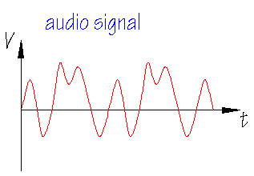
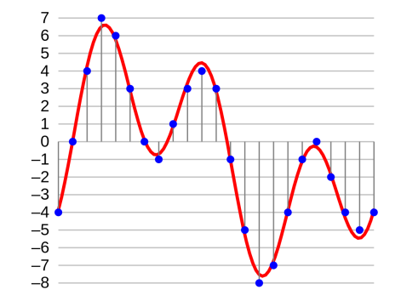

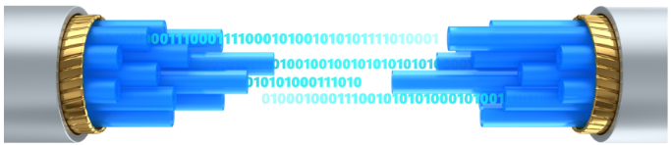
Analog – continuous time and continuous value from very quiet to extremely loud (and everything in between) – infinite number of values
Digital – discrete time and quantized value button pressed or not, or music on CD or USB stick – finite number of values
Input is analog
Signal is analog
MP3
WAV
FLAC
AIFF MP4
MKV MPEG
binary
ADC
Digital data stream or storage on CD, USB, HDD, Cloud, etc.
Analog signal sampling
binary
Digital data
Notes:
Definition: An analog signal is a continuous wave denoted by a sine wave and may vary in signal strength (amplitude) or frequency (time). Most analog signals are a composition of different sine waves.

Slide 6
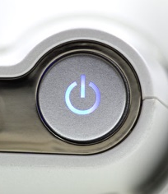
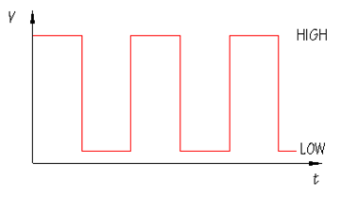
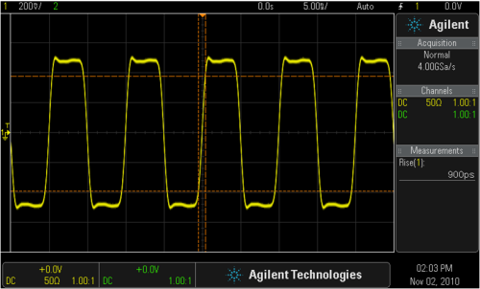
Digital data and analog signal
Input is digital (on/off)
Signal is analog
Notes:
Definition: An analog signal is a continuous wave denoted by a sine wave and may vary in signal strength (amplitude) or frequency (time). Most analog signals are a composition of different sine waves.

Slide 7
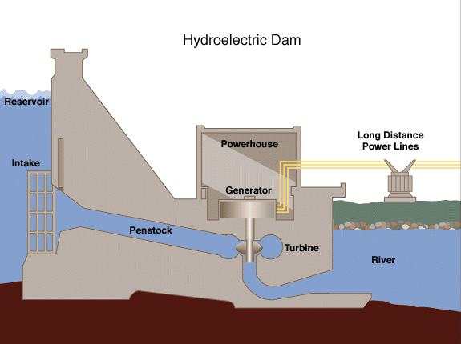
How to measure analog?
Example:
Intake gate for hydroelectric plant.
How far is a gate open?

Slide 8
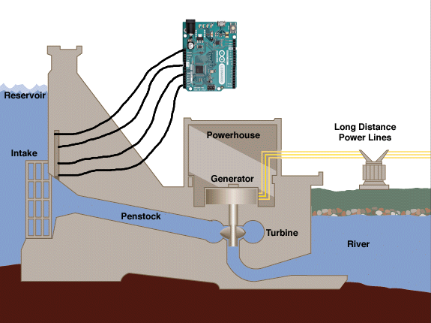
Analog Input
Attach many switches to the fence.
Now we have 4 levels

Slide 9
4 switches = not very efficient.
Suppose we want to know 100 levels

Slide 10
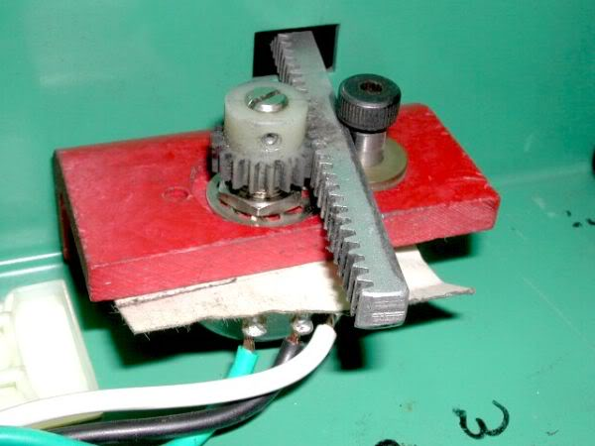
Analog Input
The inlet fence
Connect a potentiometer to the fence

Slide 11
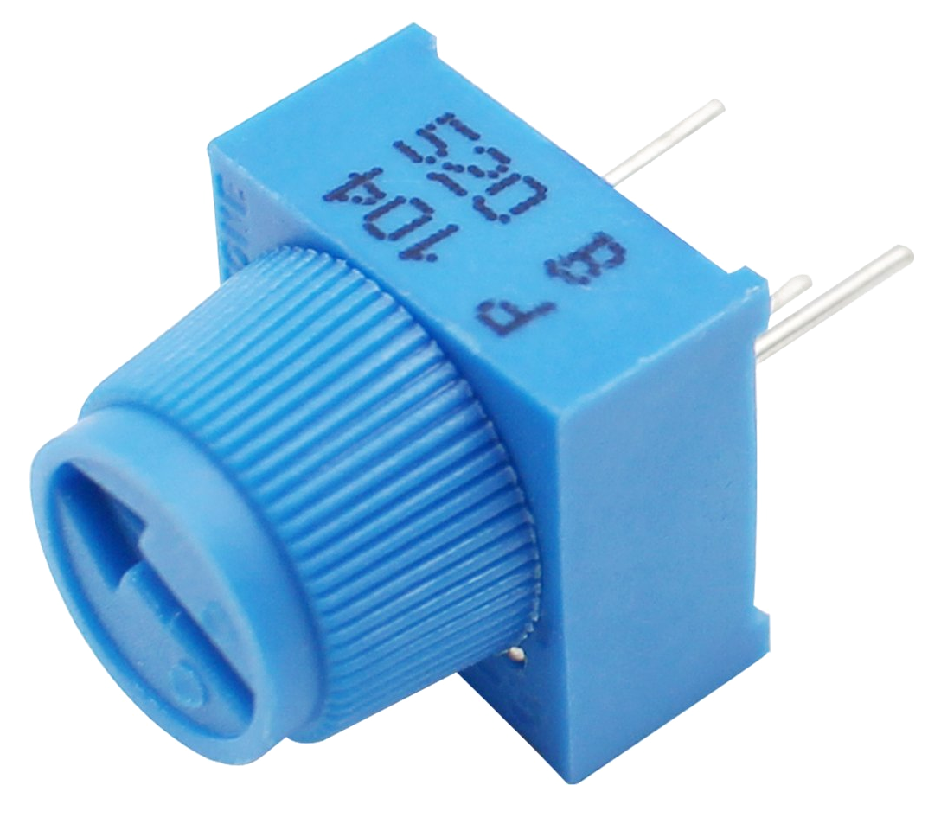
Analog I/O
Arduino has a dedicated port for reading an analog I/O
Use a potentiometer

Slide 12
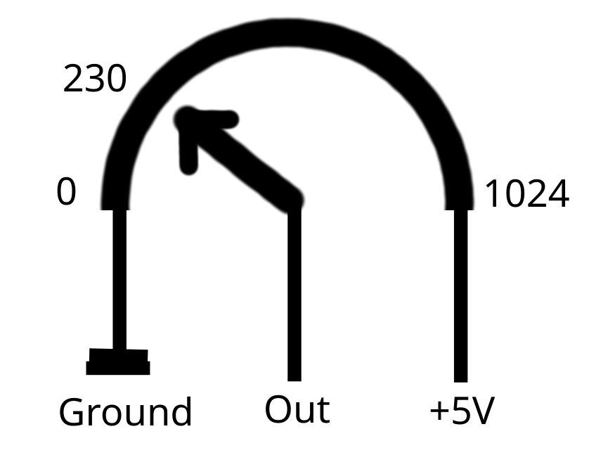
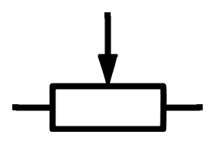
Reading a potentiometer
Values run from 0 – 1023
Connected to Analog Input
Configure port:
pinMode(POTPIN, INPUT);
read value with:
val = analogRead(POTPIN);

Slide 13
Example code
const int POTPIN = 0;
int val = 0;
void setup()
{
pinMode(POTPIN, INPUT);
pinMode(LEDPIN, OUTPUT);
}
void loop()
{
val = analogRead(POTPIN);
digitalWrite(LEDPIN, HIGH);
delay(val);
digitalWrite(LEDPIN, LOW);
delay(val);
}

Slide 14
Variables Revisited

Slide 15
Variable declaration & initialization
int i;
i = 0;
int i = 0;
int k, l;
int k = 0, l = 0;
Valid characters are: a-z, A-Z, 0-9, _ (=underscore)
Names must start with a letter(small or capital)
Uninitialized variables have an undefined value
Declare variable closest to place of first use

Slide 16
Variables in C
Basic types
[unsigned] char
[unsigned] short
[unsigned] int
[unsigned] long
[unsigned] long long
float
double
Minimum (actual size depends)
8 bit (0-255, -127-127)
16 bit (0-65535, -32767-32767)
16 bit
32 bit (0-4294967295)
64 bit (0-18446744073709551615)
32 bit
64 bit
Notes:
The actual size depends on the processor. int could be 16bit or 32bit

Slide 17
Better types
int8_t
uint8_t
int16_t
uint16_t
int32_t
uint32_t
8 bit int signed
8 bit int unsigned
etc.

Slide 18
Constants
variables can be made constant
const int P_LED1 = 12;
old way of doing this:
#define P_LED1 12

Slide 19
Variables have scope
Block Scope
Local to the block
(can’t be accessed outside)
Global scope
Global to the program
(access anywhere)

Slide 20
Scope of variables
In C you can only use a variable in the scope in which it is declared.
there are two kinds:
block scope, only valid between the matching { and }
global scope, valid in the whole program

Slide 21
Scope of variables (II)
void loop()
{
if (LED_OFF)
{
int i = 10;
while (i < 14)
{
digitalWrite(i, LOW);
i++;
}
}
}
void loop()
{
int i = 10;
if (LED_OFF)
{
while (i < 14)
{
digitalWrite(i, LOW);
i++;
}
}
}
good practice: make the scope as small as possible

Slide 22
Scope of variables (III)
void setup()
{
int nrofLeds = 3;
}
void loop()
{
int i = 0;
while (i < nrofLeds)
{
digitalWrite(LEDPIN0 + i, HIGH);
i++;
}
}
nrofLeds is unknown in this scope!
Notes:
Buiten de block scope is de variabele NIET bekend.
Hoe het probleem in dit voorbeeld op te lossen: globale scope

Slide 23
Global variables
const int nrofLeds = 3;
void loop()
{
int i = 0;
while (i < nrofLeds)
{
digitalWrite(LEDPIN0 + i, HIGH);
i++;
}
}

Slide 24
Good practice: coding standard (I)
Coding standard = rules to write good software
In an if, always use { and }, even if there is only one statement inside
if (i > 15)
{
digitalWrite(LEDPIN, HIGH);
}

Slide 25
Good practice: coding standard (II)
{ and } are always on a new line
indent the code in the block
between { and }
use spaces around the operators:
+, -, /, ||, &&, etc.
if ((i > 15) && (k < 100))
{
digitalWrite(LEDPIN, HIGH);
delay(100);
}
tip: Ctrl-T for auto-format in the Arduino IDE

Slide 26
Operators
c = a + b
a = a - b
c = a++
a = ++a
c = a--
a = --a
a -= b
b += c
=
!=
<
>
<=
>=
&&
||

Slide 27
Resources
https://en.wikipedia.org/wiki/C_data_types#Basic_types
https://en.cppreference.com/w/c/types/integer

